Slide 1
Introduction To Information
And
Communication Technologies
(Lecture 1)
By: UmerFarooq

Slide 2
What is Computer?
Definition:
A computer is normally considered as calculating machine
that can perform arithmetic operation at a very high
speed.
Computers are electronic devices that is programmed to
accept data (input),
(process) that data into useful information,
produce (output), and then
(store) for later use.

Slide 3
What is Computer?
But…
You may already know that you can use a computer to type documents, send email, play games, and browse the Web.
You can also use it to edit or create spreadsheets, presentations, and even videos.
Computers come in many shapes and sizes, and they perform many different functions in our daily lives. When you withdraw cash from an ATM, scan groceries at the store, or use a calculator, you're using a type of computer.

Slide 4
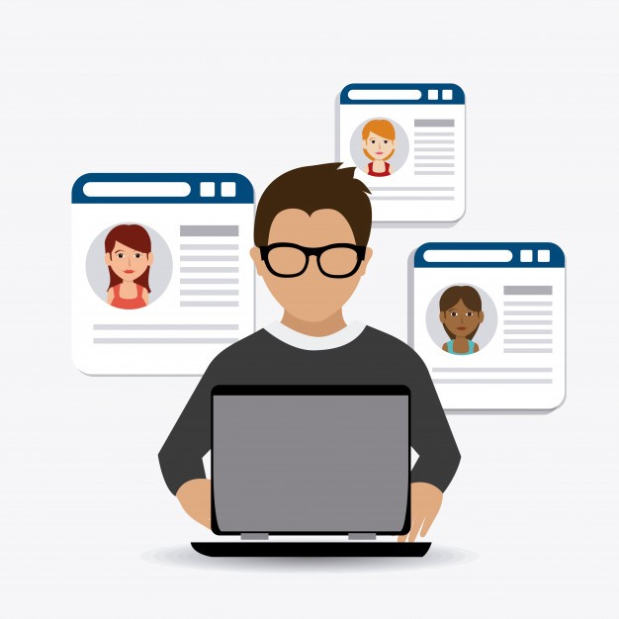
Who is a user?
Someone who communicates /interacts with a computer.

Slide 5
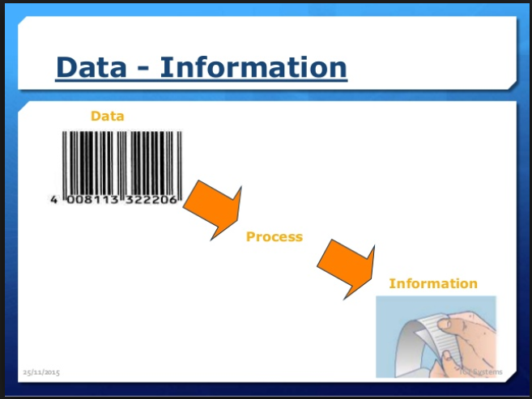
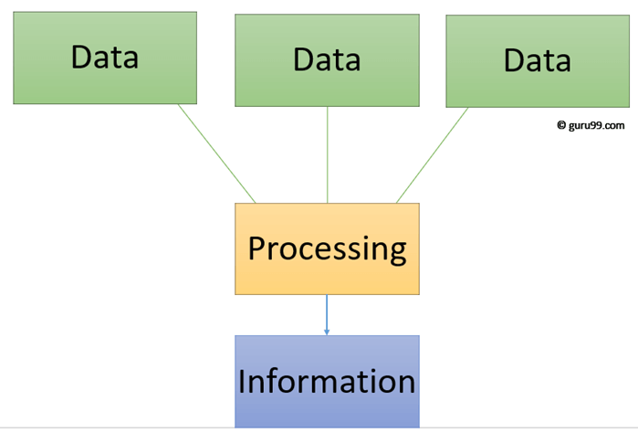
Data & Information
DATA
A collection of raw facts and figures is called data.
It may consist of numbers, characters, symbols etc.
INFORMATION
Processed data is called information.
It is more meaningful than data.

Slide 6
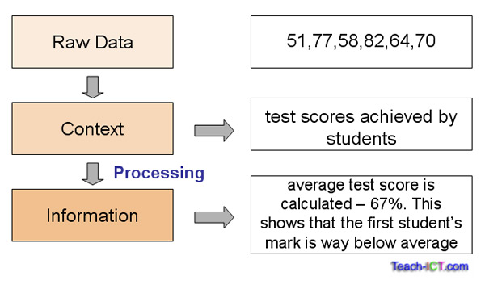
Data & Information (Cont..)

Slide 7
What is Computing?
the use of a computer to process data or perform calculations. the act of calculating

Slide 8
Few Computing Environments
Client-Server computing
Distributed computing
Cloud computing
Many more……

Slide 9
Purpose of Computing?
The purpose of the computer is to perform calculations, store information, retrieve data and process information.
A computer has programmed data or computer language that tells the computer how to fulfill its purpose.

Slide 10
Software
Its a collection of computer instructions that tell the computer how to work.
Application Software Uses the computer system to perform special functions or provide entertainment functions beyond the basic operation of the computer itself.
System Software It directly operates the Computer Hardware, to provide basic functionality needed by users and other software, and to provide a platform for running application software.

Slide 11
Few Examples
Basic examples of system software include:
Utility software.
System servers.
Device drivers.
Operating system (OS)
Windows/graphical user interface (GUI) systems.
Few application software are:
MS Word, WordPad and Notepad.
Internet browsers like Firefox, Safari, and Chrome.
Microsoft Power Point, Keynotes.
Auto CAD.
MySQL, Oracle, MS Access.
Microsoft Excel.
Real Player, Media Player.

Slide 12
Information Technology
Information is data that is organized, meaningful, and useful.
Information technology is the use of systems (especially computers and telecommunications) for storing, retrieving, and sending information.
Computer is a very important component of information technology

Slide 13
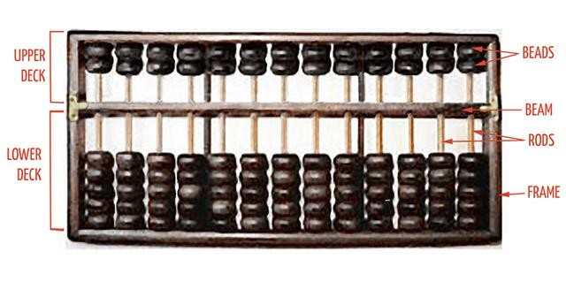
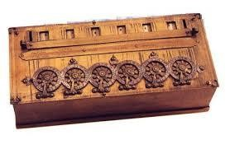
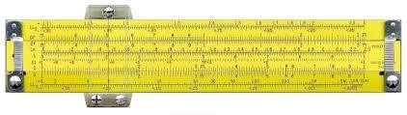
Mechanical Computers (1600 – 1900)
Pascal Calculator
Abacus
Slide Rule

Slide 14
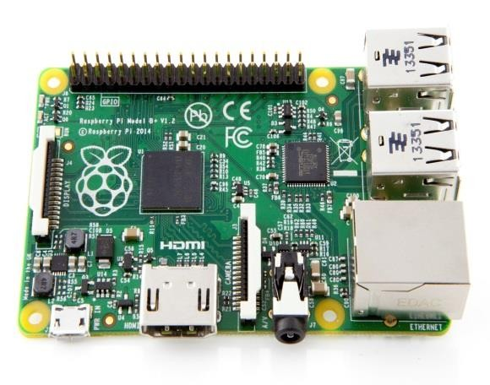
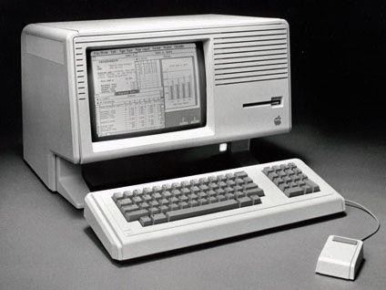
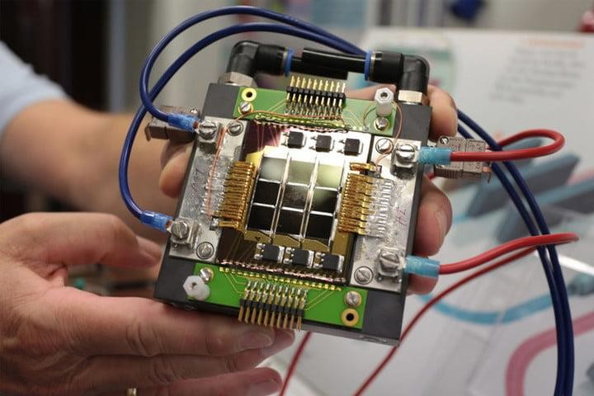
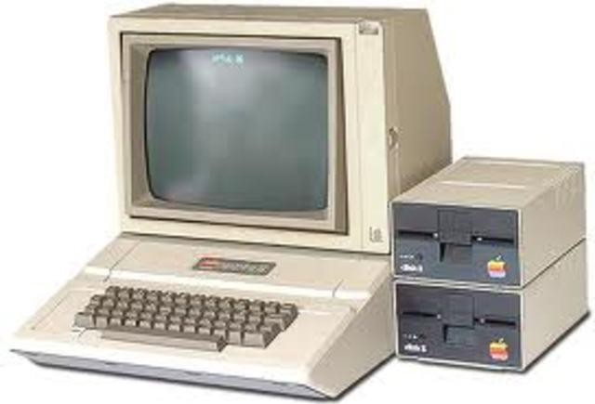
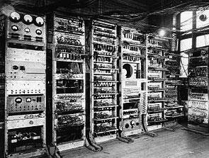
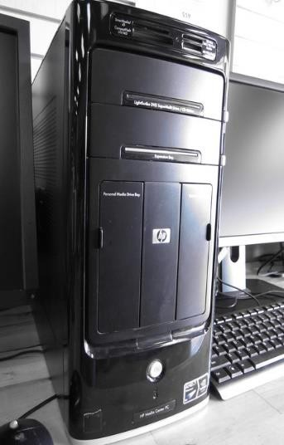
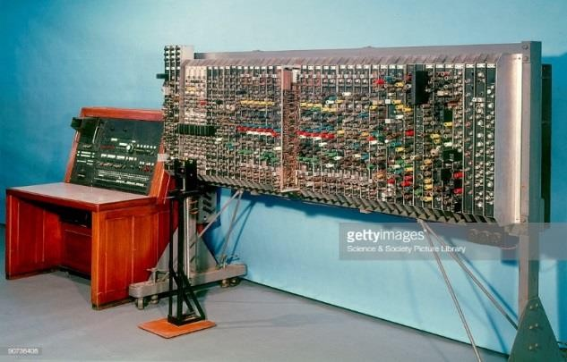
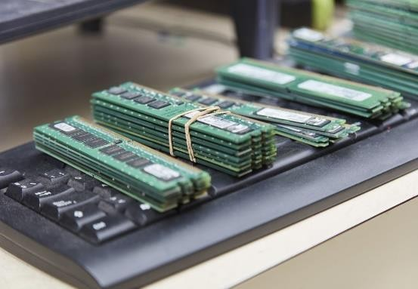
Electronic computers (1937 - 1953)
Notes:
EC have Chips inside

Slide 15
Evolution of Computers
First Generation of Computers (1942 - 54) : Vacuum Tubes
Second Generation Computers (1952 - 1964) : Transistors, Magnetic core, Fortran ,COBOL
Third Generation Computers (1964 - 1972) : Integrated Circuits, Fortran II to IV
Fourth Generation Computers (1972 – 1990) : VLSI, C, C++
Fifth Generation (1990 - Present) : Artificial Intelligence+ ULSI
Sixth generation (Future)
Notes:
VLSI- very large scale integration
ULSI-Ultra large scale integration

Slide 16
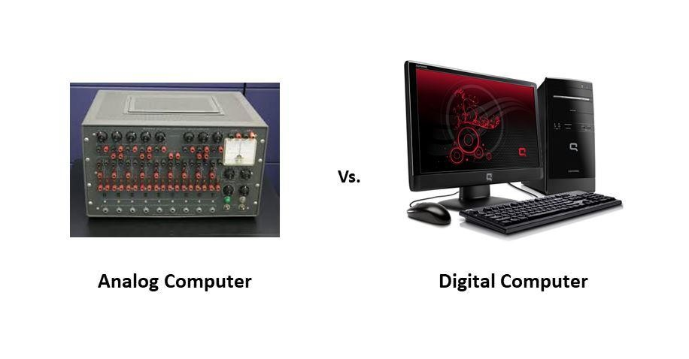
Types of Computer
Analog Computers
Digital Computers

Slide 17
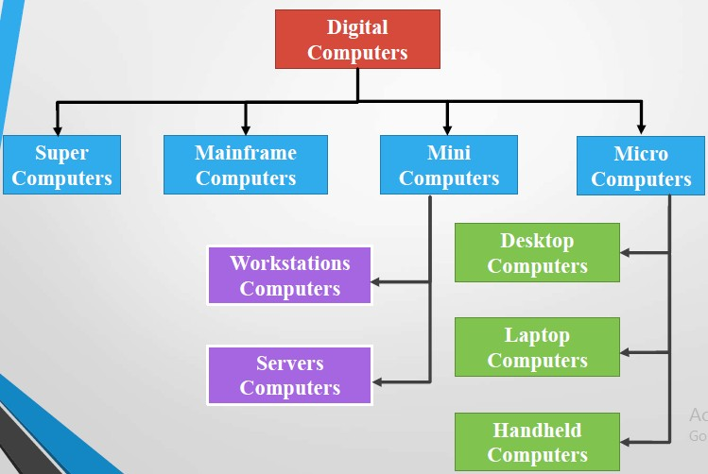
Classification of Computers

Slide 18
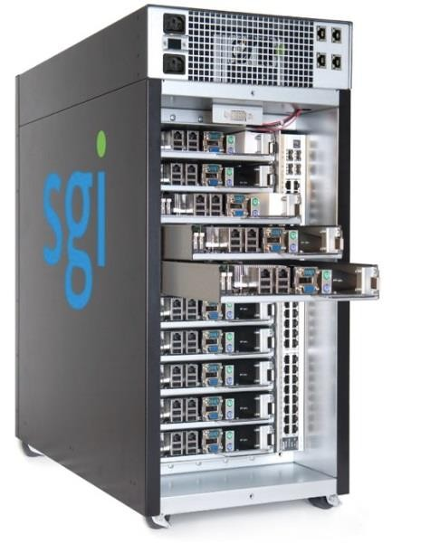
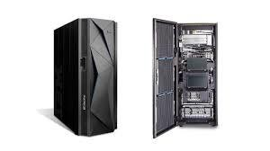
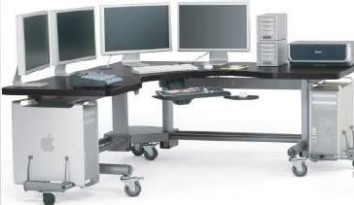
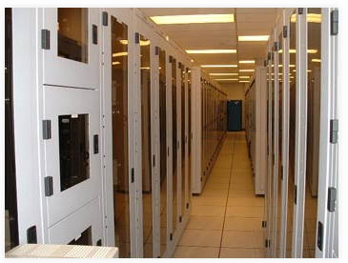
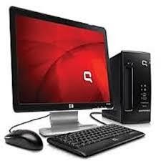
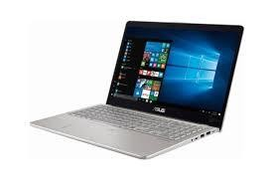
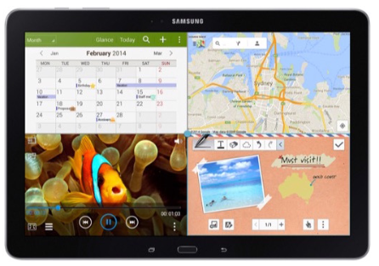
Classification of Computers
Mainframe Computers
Workstation
Super Computers
Server
Desktop
Laptop
Tablet

Slide 19
Other Types of Computers
Few common examples,
Smartphones: Many cell phones can do a lot of things computers can do, including browsing the Internet and playing games. They are often called smartphones.
Wearables: Wearable technology is a general term for a group of devices—including fitness trackers and smartwatches—that are designed to be worn throughout the day. These devices are often called wearables for short.
Game consoles: A game console is a specialized type of computer that is used for playing video games on your TV.
TVs: Many TVs now include applications—or apps—that let you access various types of online content. For example, you can stream video from the Internet directly onto your TV.

Slide 20
Modern Applications
Computers have been used over the years in following areas:
Business
Education
Entertainment
Banks
Hospitals
Information
Communication
Etc….

Slide 21
Modern Applications
In almost every second of our lives we are interacting with computers :
Amazon Alexa
Humanoid R obots(Sophia)
Augmented R eality
Driver less cars + Navigations
Wars (Drone)

Slide 22



Trends in Computer Science
Computer Science
Research
Development

Slide 23
Trends in Research
Artificial Intelligence (Machine learning , Deep Learning ,Neural Network)
NLP(Processing , Understanding )
Big data Analytics
Cyber Security(Blockchain , digital money)
Bio Informatics

Slide 24
Trends In Industry/Development
Applied Machine learning(Python)
Data Analytics(Hadoop, Apachee,Hive)
Progressive Web Apps
Mobile app development
Graphics Designing / Game Development /logo designing

Slide 25
Required skills
Experience with AI
Designing skills
Ability To Adapt To New Tech
Coding And Engineering Experience
Programming Knowledge
Cross-Team Functionality And Communication

